Slide 1
CS2040 Lab07 B03 (Please set up your camera for Visualgo quiz) 12/10/2020

Slide 2
Nearest
Lab6 Problem 1

Slide 3
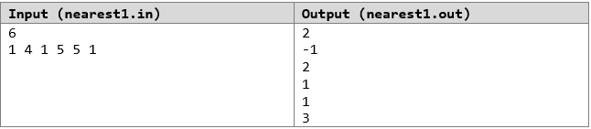
Problem Statement
Given an array of integers of lengths n
For each element in the array, we want to find the distance of the nearest element (either to the left or to the right) that is equal to it

Slide 4
Ideas
Initialize minimum[n] <- N + 1
For each element a[i] from left to right of array:
(1) if a[i] not in hashmap, put (a[i], i) into hashmap
(2) if a[i] in hashmap, minimum[i] = min(minimum[i], i – map.get(a[i])) and put(a[i], i) into hashmap (update the hashmap)
In this way, we find equal element left of current element.
Similarly loop from right to left of array, and update minimum[n]
Expensive Traversals that can be mitigated with help of HashMap

Slide 5
Visualization
First Loop from left to right of array (Find equal element left of current element)
1 | 4 | 1 | 5 | 5 | 1
map.containsKey(a[i]) → False
map.put(a[i], i) → (1, 0)
1 | 4 | 1 | 5 | 5 | 1
map.containsKey(a[i]) → True
Store currIndex - map.get(a[i]) → 2 - 0
map.put(a[i], i) → (1, 2)

Slide 6
Visualization
First Loop from left to right of array (Find equal element left of current element)
1 | 4 | 1 | 5 | 5 | 1
map.containsKey(a[i]) → True
Store currIndex - map.get(a[i]) → 5 - 2
map.put(a[i], i) → (1, 5)

Slide 7
Website
Lab6 Problem 2

Slide 8
Idea
Store information about the website and each country (number of distinct IPs, maximum access duration from any IP) in suitable data structures.
Upon query, we want to access the desired information from the respective data structure quickly in O(1) time.
Use HashMaps and HashSets!

Slide 9
Data Structures
HashMap<Country, HashSet<IP>> uniqueIPs:
Store the unique IPs from each country in a HashSet.
HashSet<Country> uniqueCountries:
Store the countries with at least one IP which has accessed the website.
HashMap<IP, Integer> IPDuration:
Store the access duration from each IP.
HashMap<country, Integer> CountryMaxDuration:
Store the maximum access duration from any IP in each country.

Slide 10
Query 1
Update IP’s access duration
IPDuration.put(IP, IPDuration.get(IP) + duration)
Update country’s maximum access duration
CountryMaxDuration.put(country, Math.max(CountryMaxDuration.get(country),
IPDuration.get(IP))
Add the IP to country’s HashSet
uniqueIPs.get(country).add(IP)
Add the country to uniqueCountries
uniqueCountries.add(country)

Slide 11
Query 2
Get the country’s maximum access duration from any IP from CountryMaxDuration.
CountryMaxDuration.get(country)

Slide 12
Query 3
Number of countries with at least one IP which has accessed the website:
Return the size of uniqueCountries.
uniqueCountries.size()

Slide 13
Query 4
Number of distinct IP from country:
Return the size of the country’s HashSet.
uniqueIPs.get(country).size()

Slide 14
Visualgo quiz

Slide 15
Visualgo quiz
10 questions in 10 minutes
Make sure you record the whole screen including the timestamp
Upload your recording to TG group immediately after the quiz (don’t edit your message if you upload a wrong video, just send another message to upload),
and name your video as NAME+MATRIC NUMBER+ SCORE
https://visualgo.net/training?diff=hard&n=10&tl=10&module=hashtable

Slide 16
Diameter
Lab7 Problem1

Slide 17
Problem statement
Find the diameter of a tree
The diameter of a tree (sometimes called the width) is the number of nodes on the longest path between two end nodes.
Input:
The first line contains a single integer n (1≤n≤1000) – the number of nodes of the tree
The second line contains n-1 integers pi (1≤pi≤n) - pi is the parent node of the (i+1)th node. The tree’s root is node 1.
It’s guaranteed that the given tree will be a binary tree.
Output: A single integer is the diameter of the tree

Slide 18
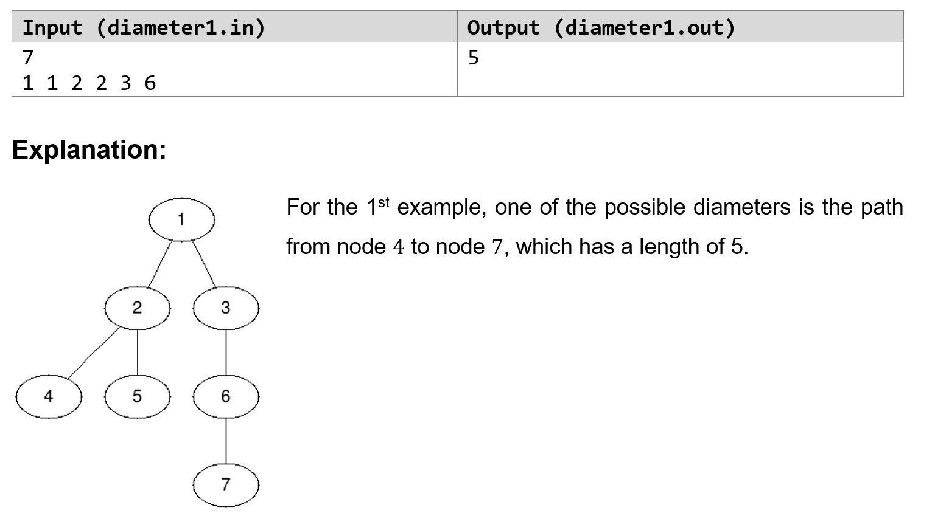
Example

Slide 19
Data structure to use
Binary tree: Create a class node which have attributes of left child, right child, and the height of the node.

Slide 20
Basic idea
Use a recursive function traverse to recursively compute the diameter and height(maxDepth) of each node (regard each node as the root of a subtree).
If a node has both left and right child, its diameter can be generated from the following three cases:
The diameter of its left child
The diameter of its right child
Go from the deepest node in its left child to the deepest node in its right child
The diameter of this node is the maximum among the diameter of its left child, the diameter of its right child, and (thisNode.left.height + thisNode.right.height + 2)

Slide 21
Things to note
Need to transform the input array in the problem to the structure of a tree
Recursive methods are often used when dealing with tree structures.
Remember to consider the case where a node has no left/right/left&right child.

Slide 22
DICTIONARY
Lab 7 Problem 2

Slide 23
PROBLEM STATEMENT
Given:
n list of words, each word consist of only ‘a’ and ‘b’ (this is your dictionary)
process q queries
Each query is a word s, and we want to check how many words from the dictionary has prefix s

Slide 24
INPUT / OUTPUT
Input:
First line contains two integers: n (number of words) and q (number of queries)
Next n lines will each contain a word in the dictionary
Next q lines will each contain a word
Output: Integers for each query, representing how many matching prefixes there are with the dictionary

Slide 25
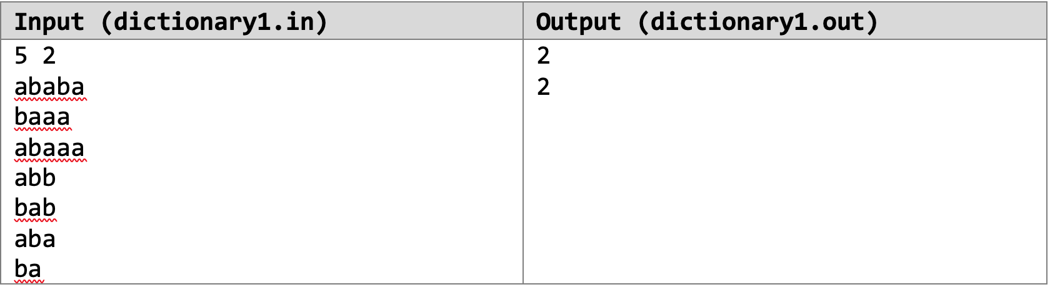
EXAMPLE

Slide 26
HINTS
Solve this problem efficiently with a binary search tree
Use the knowledge that each of the string in your dictionary can only have characters ‘a’ and ‘b’ (binary values…?)
Either treat ‘a’ > ‘b’ or ‘b’ > ‘a’, such that when searching, one of them represents a smaller value (going left) and the other represents a larger value (going right)
All the strings can thus be inserted into the single tree, and a traversal can be done to determine the number of strings with the matching prefix

Slide 27
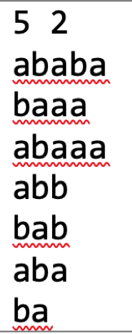
EXAMPLE FROM TEST CASE
R
HOW to put them in tree?
A
B
B
A
HOW to count matching prefixes for each query?
A
B
A
B
A
B
A
A
A

Slide 28
NOTES
You are strictly forbidden from using hash tables and ALL its variants, and API tree and ALL its variants.
You are highly encouraged to write your own code for the tree and/or node data structure (a node can represent a tree)
You might want to keep track the sizes of subtrees that are rooted at each node, or have a traversal method to update them once your tree is enumerated

Slide 29
Lowest Common Ancestor(LCA)
Lab 7 Problem 3

Slide 30
Problem
Given a BST, find the Lowest Common Ancestor between 2 nodes (u, v). Repeat for q queries.
Definition: node u is an ancestor of node v if u lies on the path from tree root to v. A node can be ancestor of itself.
LCA of (u,v) is the lowest node in a tree that is the ancestor of both u and v.
Constraint: 1 ≤ u, v ≤ n. Assumes both nodes are present in the tree.

Slide 31
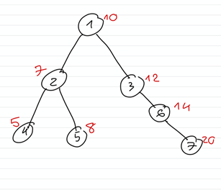
Example
u | v | LCA
Node 4 | Node 5 | Node 2
Node 6 | Node 7 | Node 6
Node 2 | Node 3 | Node 1
For each query, output LCA node number in a new line.

Slide 32
Solution
Given BST property, if node u < node v
Value(node u) < Value(LCA) ≤ Value(node v)
Idea:
Find the node which has node u in left subtree while node v in right subtree

Slide 33
Top-down Approach
Traverse tree iteratively from root node
At each new node (node u < node v)
If Value(new node) < Value(node u), go right
If Value(new node) > Value(node v), go left
Exit conditions:
Value(new node) > Value(node u) && Value(new node) < Value(node v)
new node == u || new node == v // compare index

Slide 34
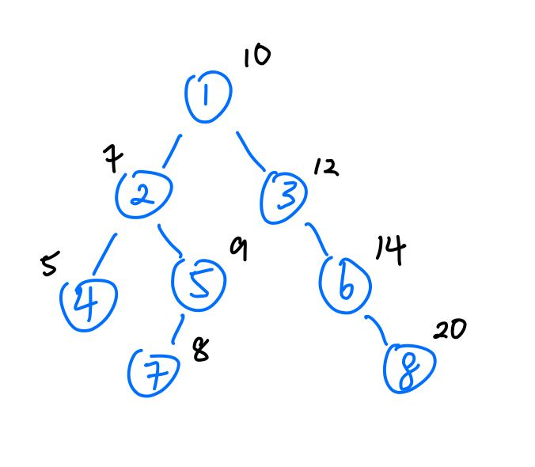
Example of exit conditions
Exit conditions:
Value(new node) > Value(node u) && Value(new node) < Value(node v)
new node == u // compare index
new node == v // compare index
u | v | LCA | Cond
Node 4 | Node 5 | Node 2 | a
Node 6 | Node 8 | Node 6 | b
Node 7 | Node 5 | Node 5 | c

Slide 35
Demo

Slide 36
What if it’s not a BST?

Slide 37
Possible Approaches
Find path from root to node u and node v. Compare both paths, LCA is last common node between 2 paths
https://www.geeksforgeeks.org/lowest-common-ancestor-binary-tree-set-1/
2. Using Range Minimum Query and Euler tour (Use knowledge of graph)
https://cp-algorithms.com/graph/lca.html

